Slide 1

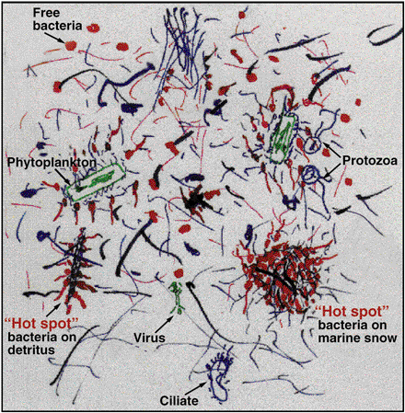
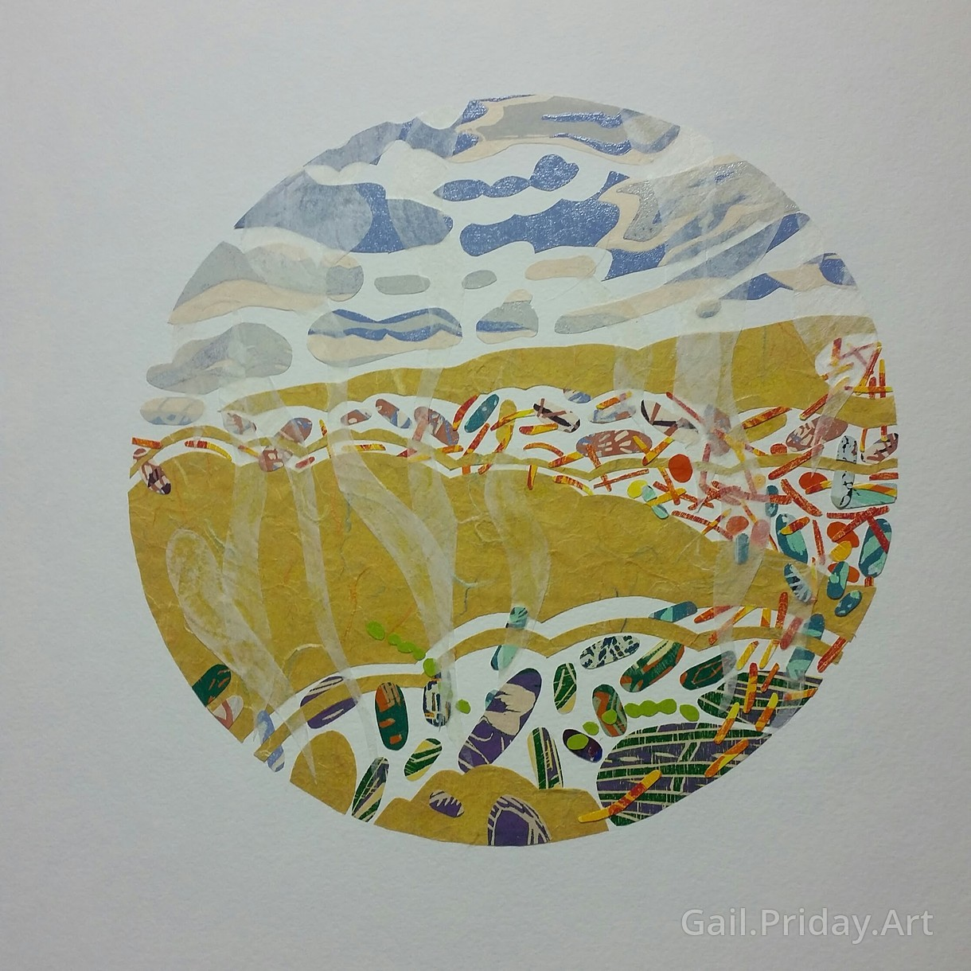
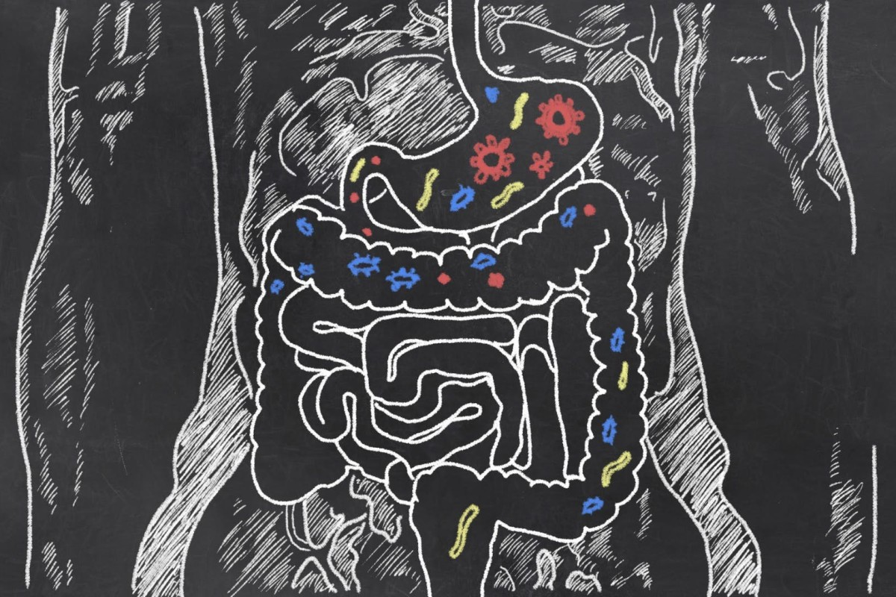
Metagenomics Lesson 1
biovcnet.github.io

Slide 2
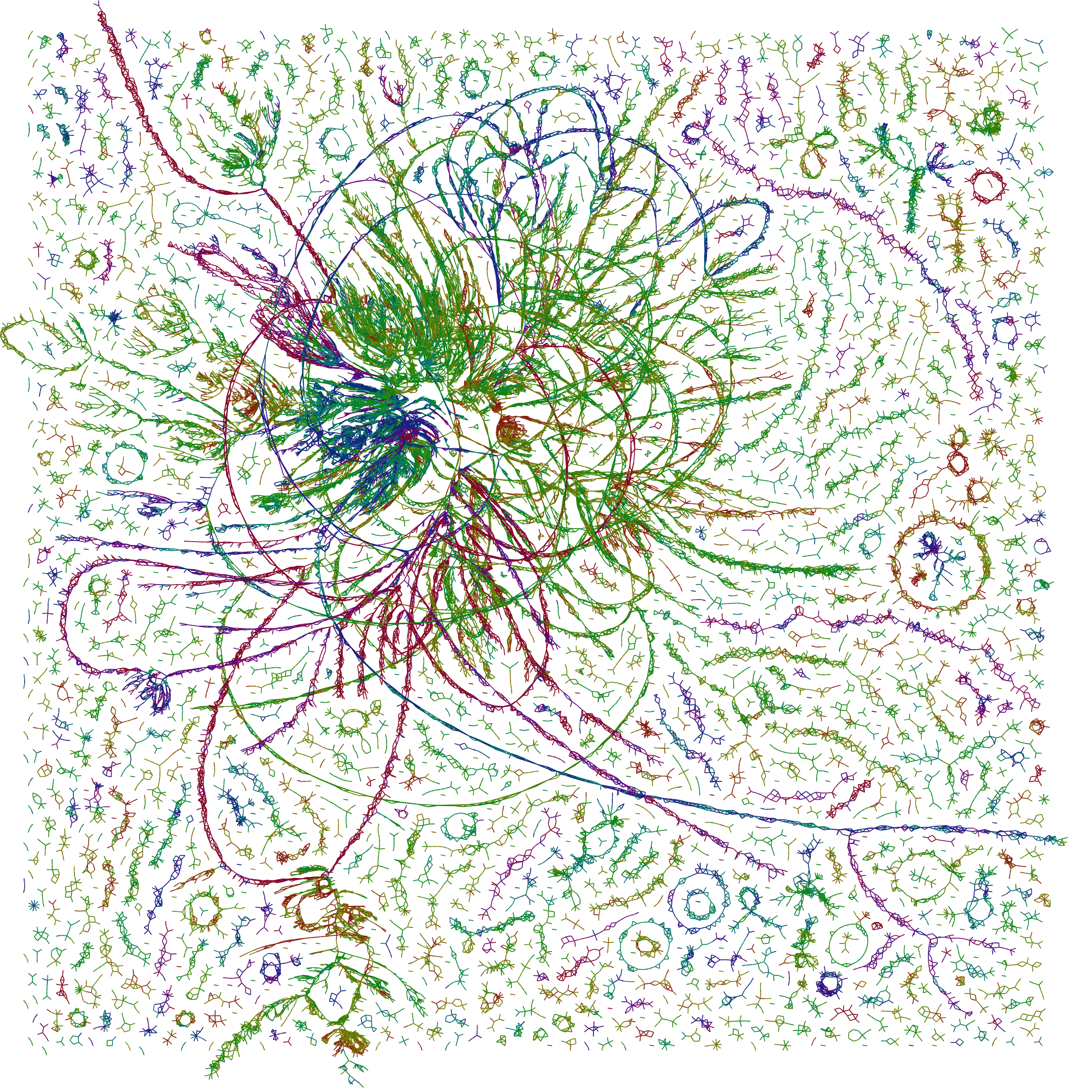
Metagenomics Lesson 1
What is Metagenomics?
What kinds of questions can
metagenomics be used to answer?
Is metagenomics right for me?
Yay! You got data! Now what?

Slide 3
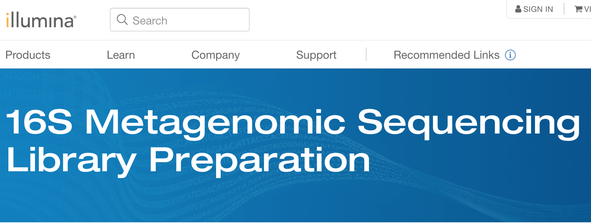
What is Metagenomics?
┏┓
┃┃╱╲ in
┃╱╱╲╲ this
╱╱╭╮╲╲house
▔▏┗┛▕▔ we
╱▔▔▔▔▔▔▔▔▔▔╲
don’t use “metagenomics”
to mean “amplicon sequencing”
╱╱┏┳┓╭╮┏┳┓ ╲╲
▔▏┗┻┛┃┃┗┻┛▕▔

Slide 4
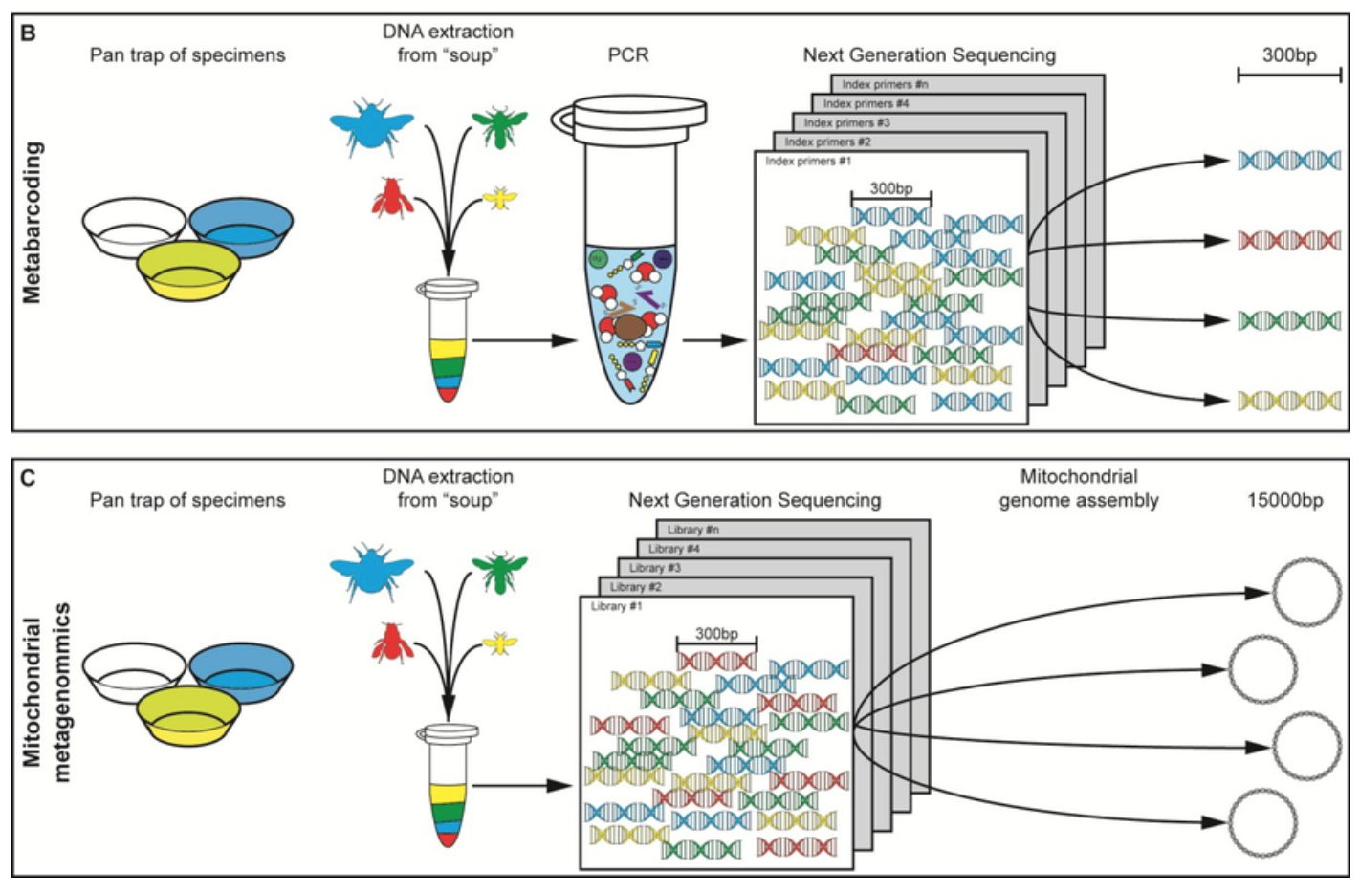
What is Metagenomics?
“Amplicon sequencing” or “metabarcoding” is sequencing a specific target region from many genomes (e.g. 16S rRNA gene, nifH gene)
“Shotgun Metagenomics” is (incomplete) sequencing of a mixture of genomes using an untargeted approach
Gill et al 2016

Slide 5
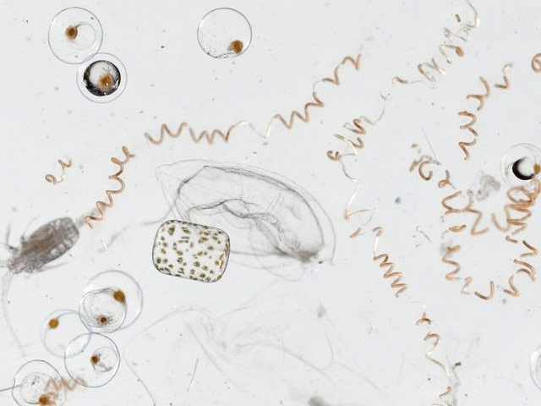
Incomplete because one drop of seawater contains about...
10⁶ bacteria/mL * 3x10⁶ bp/bacteria = 3x10¹² bp/mL
10³ euks/mL * 3x10⁸ bp/euk = 3x10¹¹ bp/mL
= 3.3 Tbp/mL
= 210 MiSeq runs/mL
= 0.5 NovaSeq run/mL
0.5 Genbank/mL = 0.2 SRA / L

Slide 6
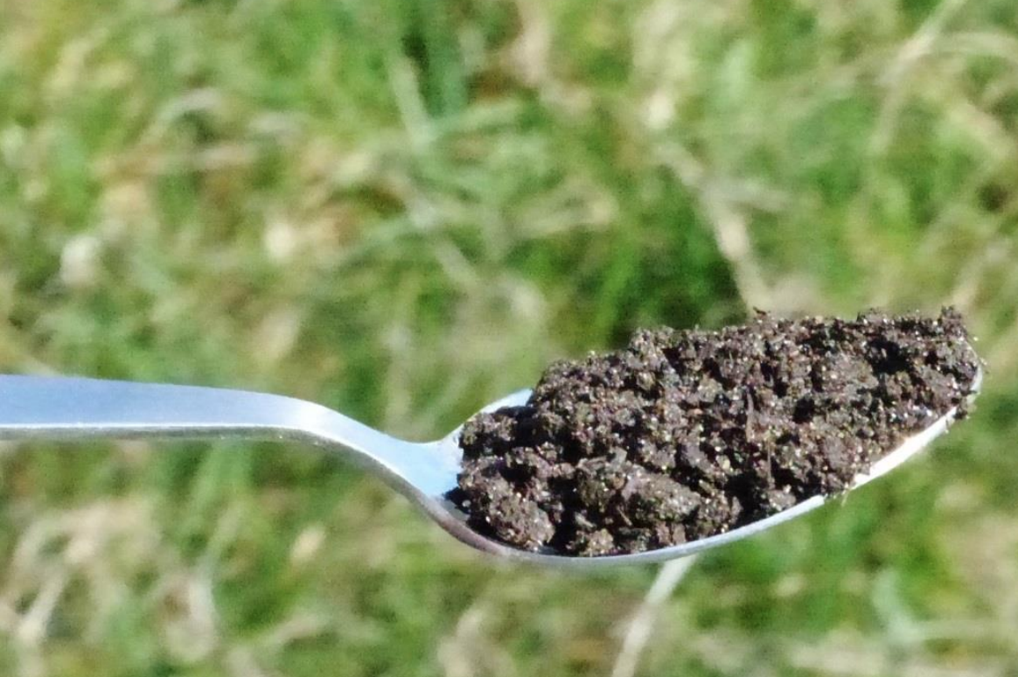
One scoop of soil contains about...
10¹⁰ bacteria/g * 4x10⁶ bp/bacteria = 4x10¹⁶ bp/g
10⁵ euks/g * 3x10⁸ bp/euk = 3x10¹³ bp/g
= 40 Pbp/g
= 2.6M MiSeq runs/g
= 6,000 NovaSeq runs/g
6,000 Genbank/g = 2.8 SRA / g

Slide 7
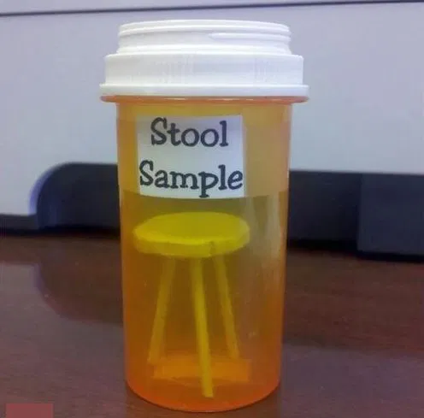
One pinch of stool contains about...
10¹¹ bacteria/g * 4x10⁶ bp/bacteria = 4x10¹⁷ bp/g
10⁶ euks/g * 3x10⁸ bp/euk = 3x10¹⁴ bp/g
10⁸ colonocytes/g * 3x10⁹ bp/cell = 3x10¹⁷ bp/g
= 700 Pbp/g
= 45M MiSeq runs/g
= 100k NovaSeq runs/g
100k Genbank/g = 40 SRA / g

Slide 8
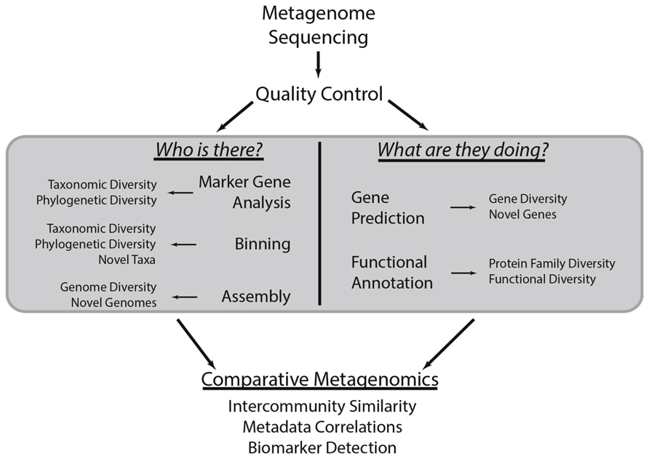
What kinds of questions can metagenomics be used to answer?
Sharpton (2014)

Slide 9
What kinds of questions can metagenomics be used to answer?
Who is there? (Taxonomy & Molecular Evolution)
Is this gene present in this sample?
How many homologs of this gene appear in this sample?
Which genomes encode this gene?
Is this pathogen present in this environment?
How closely related is this uncultured strain to this cultured representative?
How many ecotypes of this bacterium appear in this environment?
How the h*ll many prokaryotic Phyla are there in the world??
What are they doing? (Community Ecology & Function)
What proteins do symbionts encode to mediate relationships with their host?
Which genes/pathways/genomes co-occur in this environment?
What antibiotic resistance genes does this community encode?
How many different carbon fixation pathways exist in hydrothermal vents?
Are there novel CRISPR-Cas systems yet to be discovered?

Slide 10
Is metagenomics right for me?
You might try amplicon sequencing if...
You need to detect rare genes or species
You’re working with eukaryotes
You have many (1000s) samples to run
You might try Quantitative PCR if...
You only care about presence/absence
You want to quantify how many copies of a gene/species is present in a sample
You might try isolate genomics if…
You can isolate your organism of interest
You’re working with eukaryotes
You might try single-cell genomics if…
Your interest is population genetics
Your interest is in novel taxa
Your interest is horizontal gene transfer and pangenomes
You might try meta-/transcriptomics if…
You want levels of gene expression
You’re working with eukaryotes

Slide 11
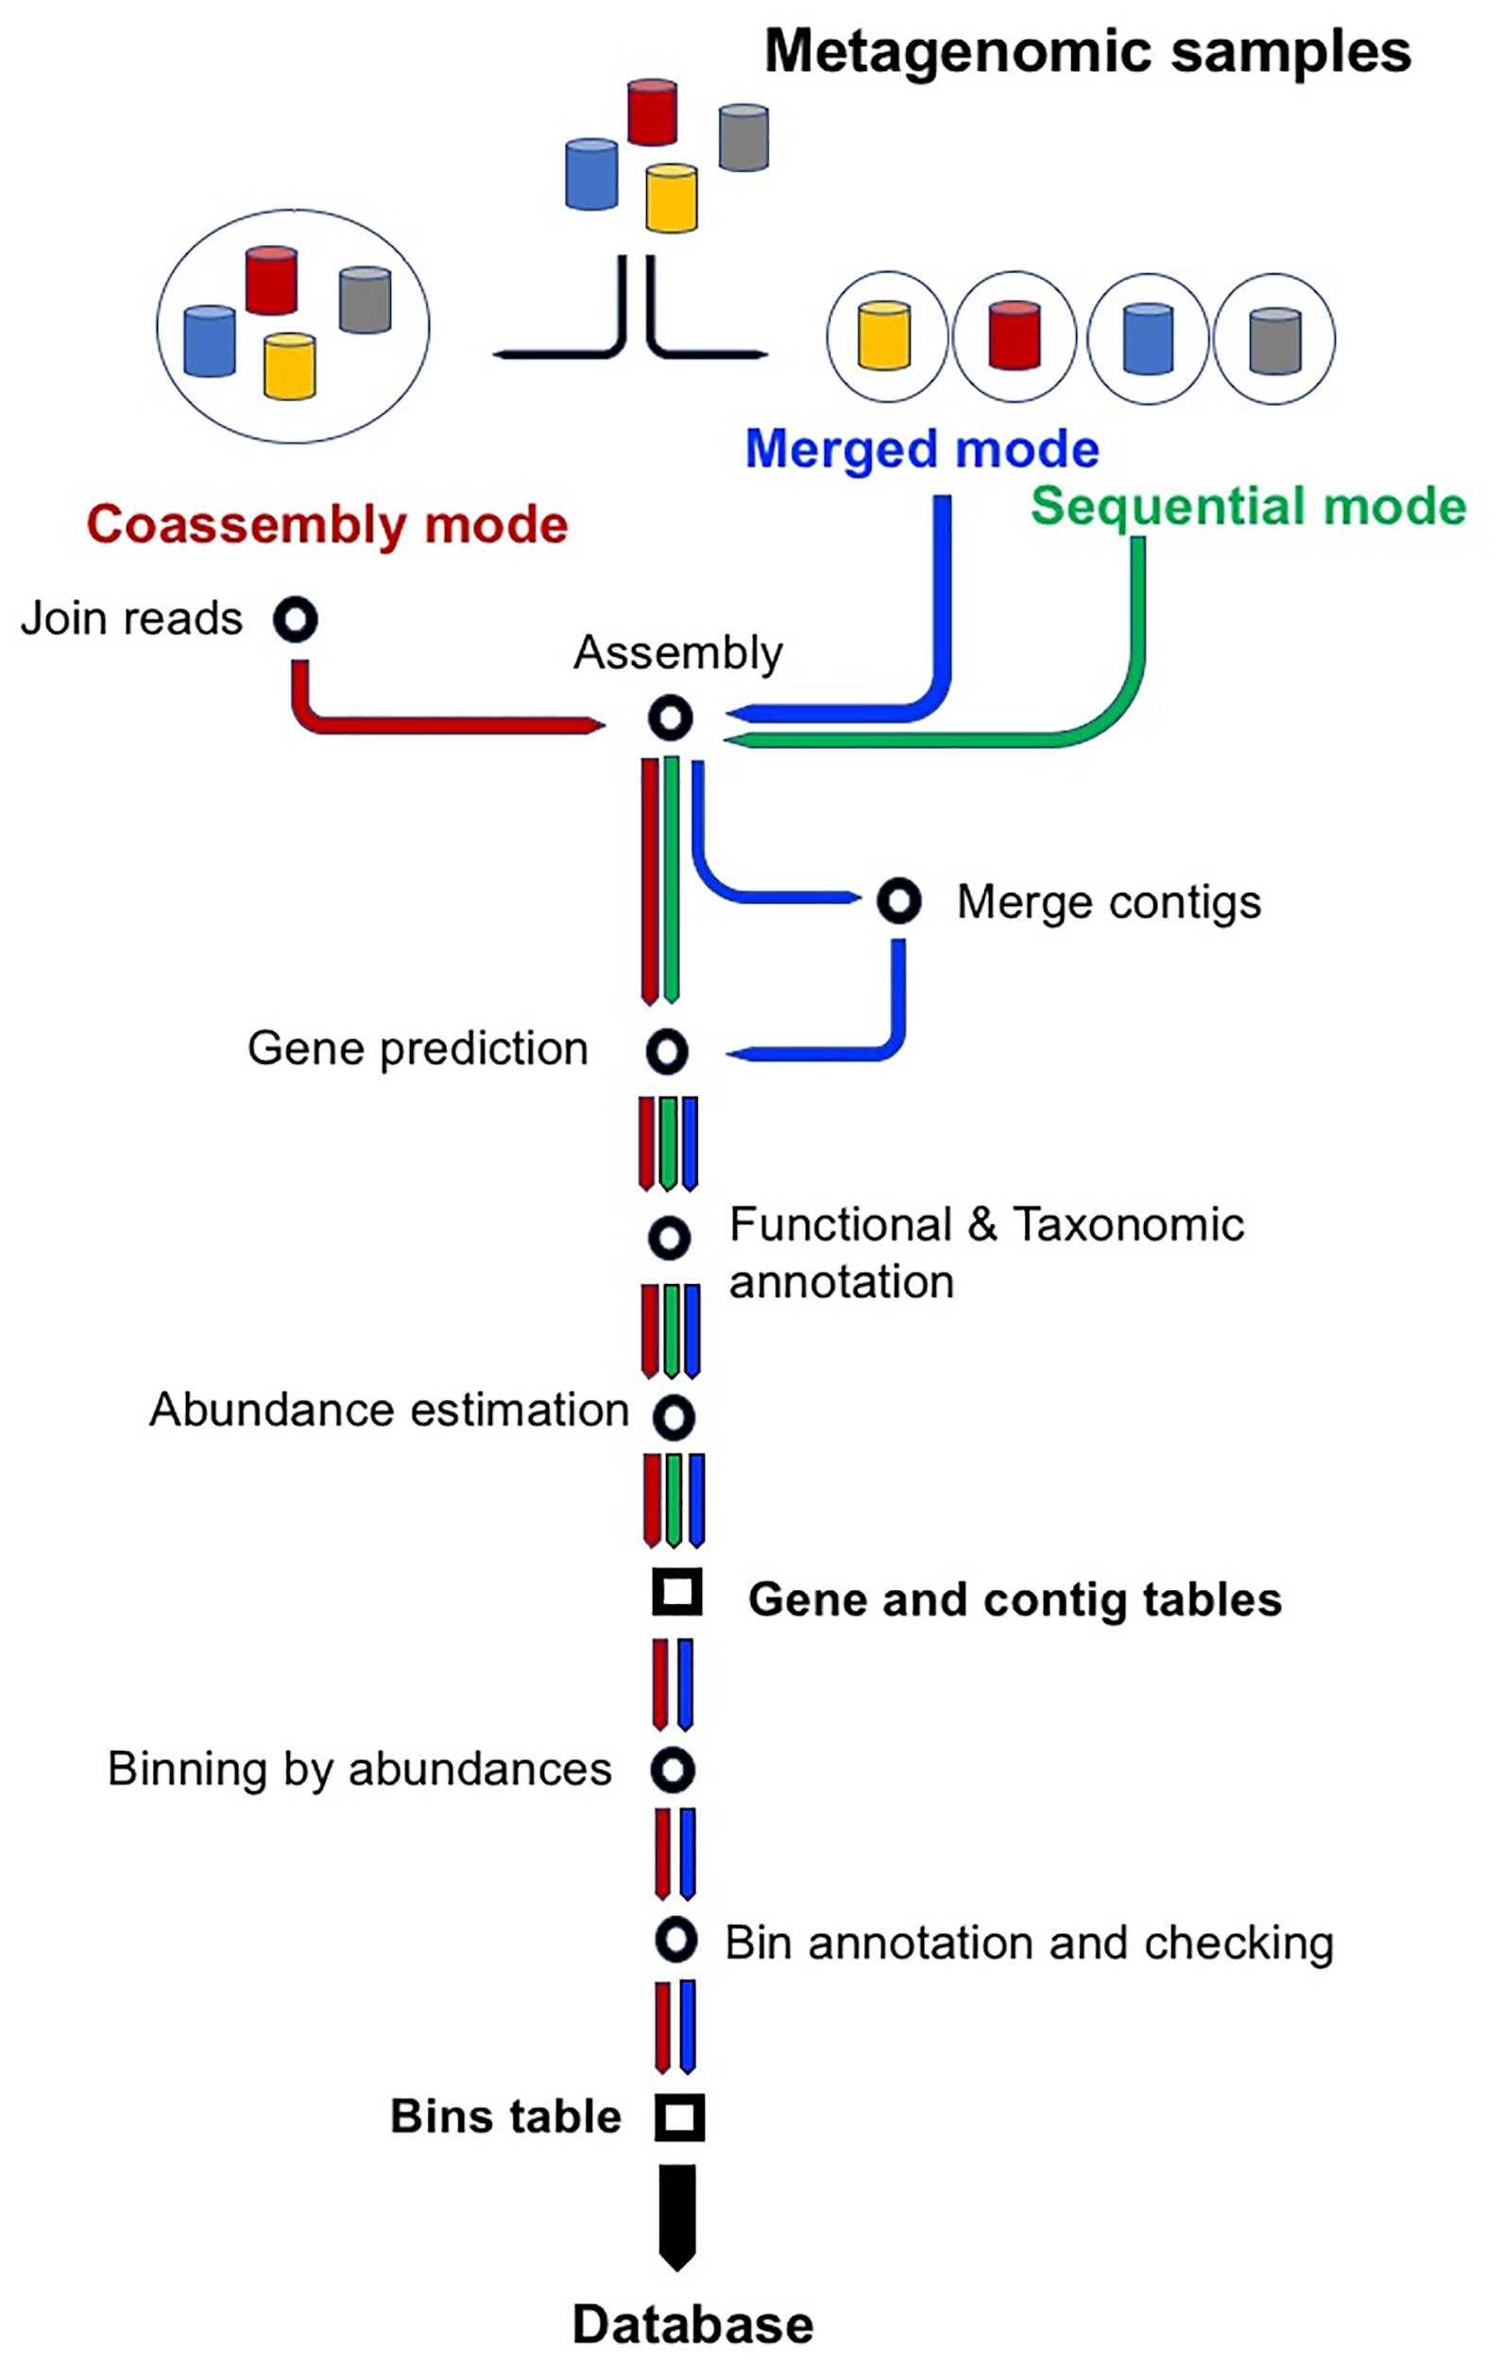
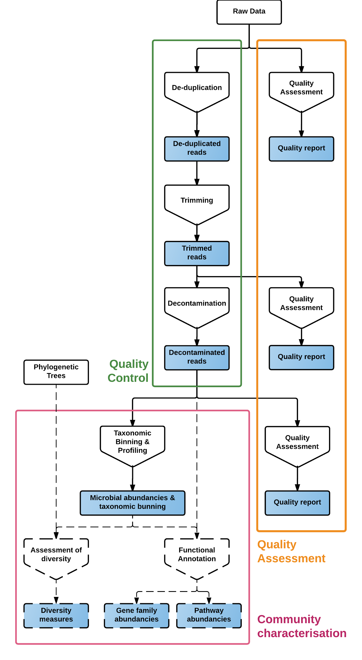
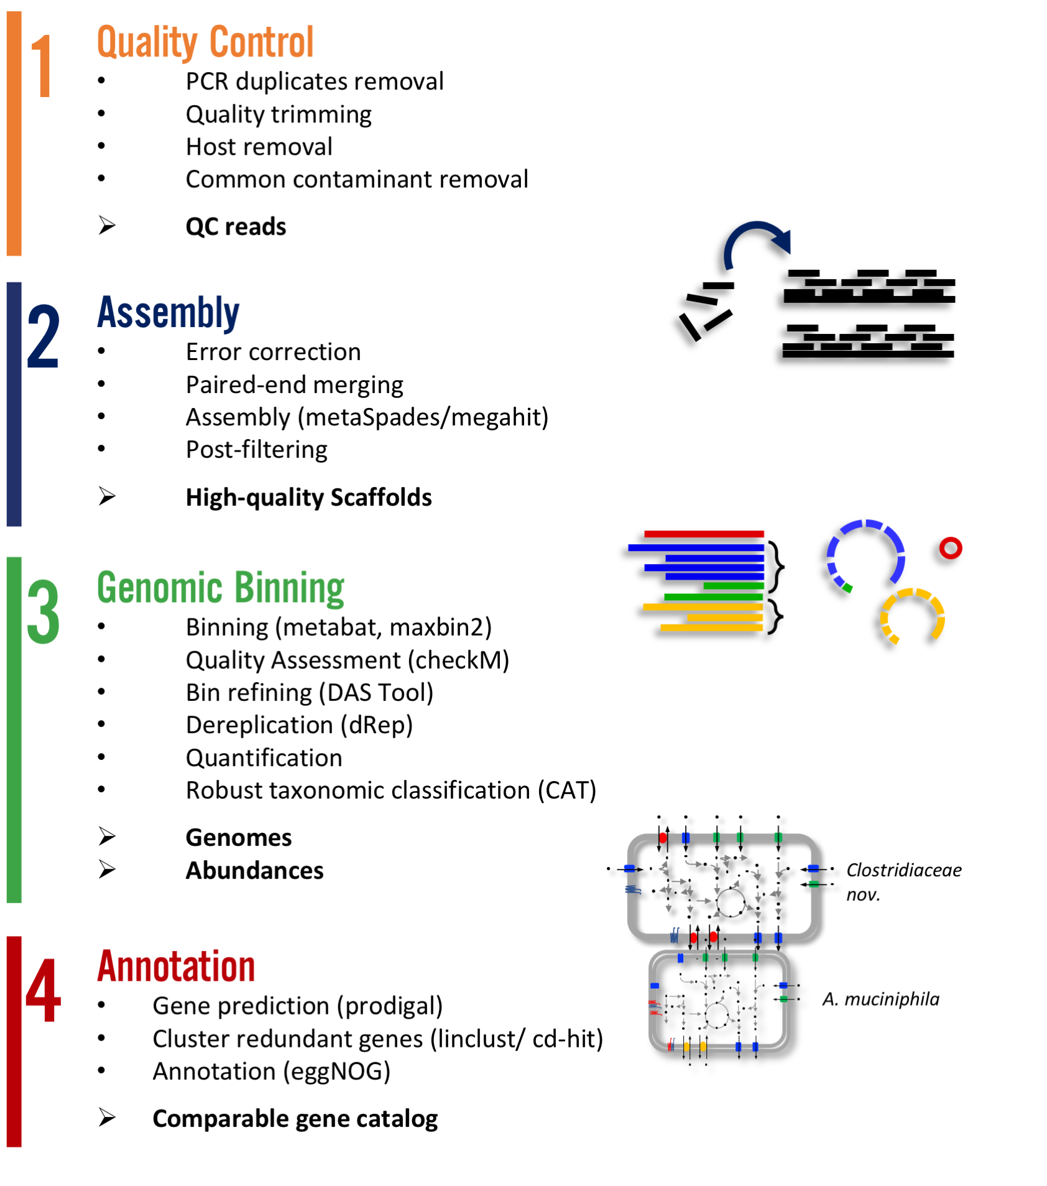
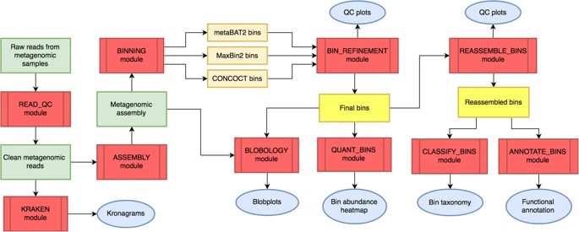
Yay!
You got data!
Now what?
YAMP
SqueezeMeta
ATLAS
MetaWRAP

Slide 12
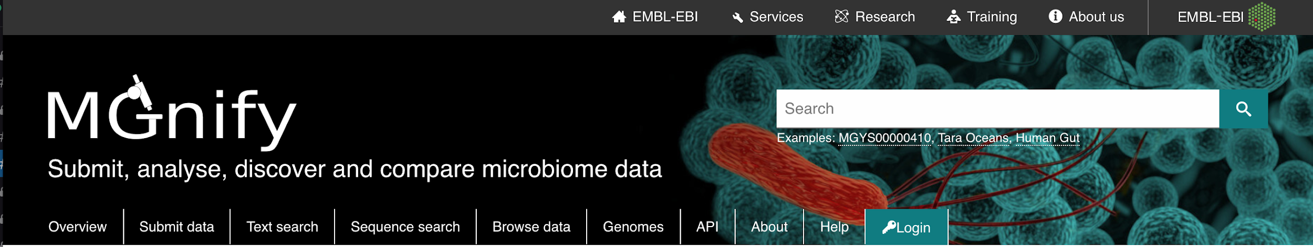
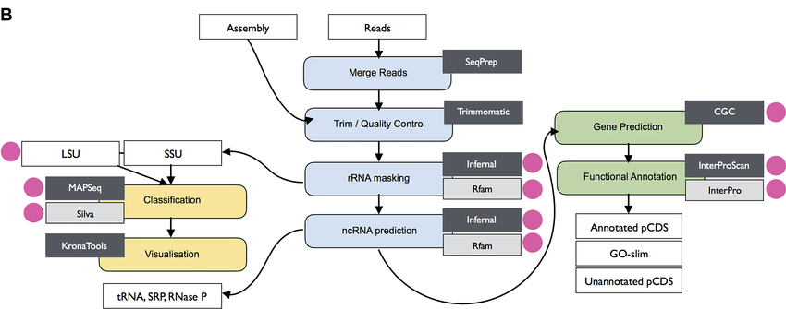

Slide 13
Future Metagenomics Lessons
Taxonomic Classification
Assembly
Binning
For more info go to: https://github.com/biovcnet/topic-metagenomics
Other BVCN Topics
#amplicons
#functionalannotation
#transcriptomics
#networkscience
#population-genetics-and-comparative-genomics

Slide 14
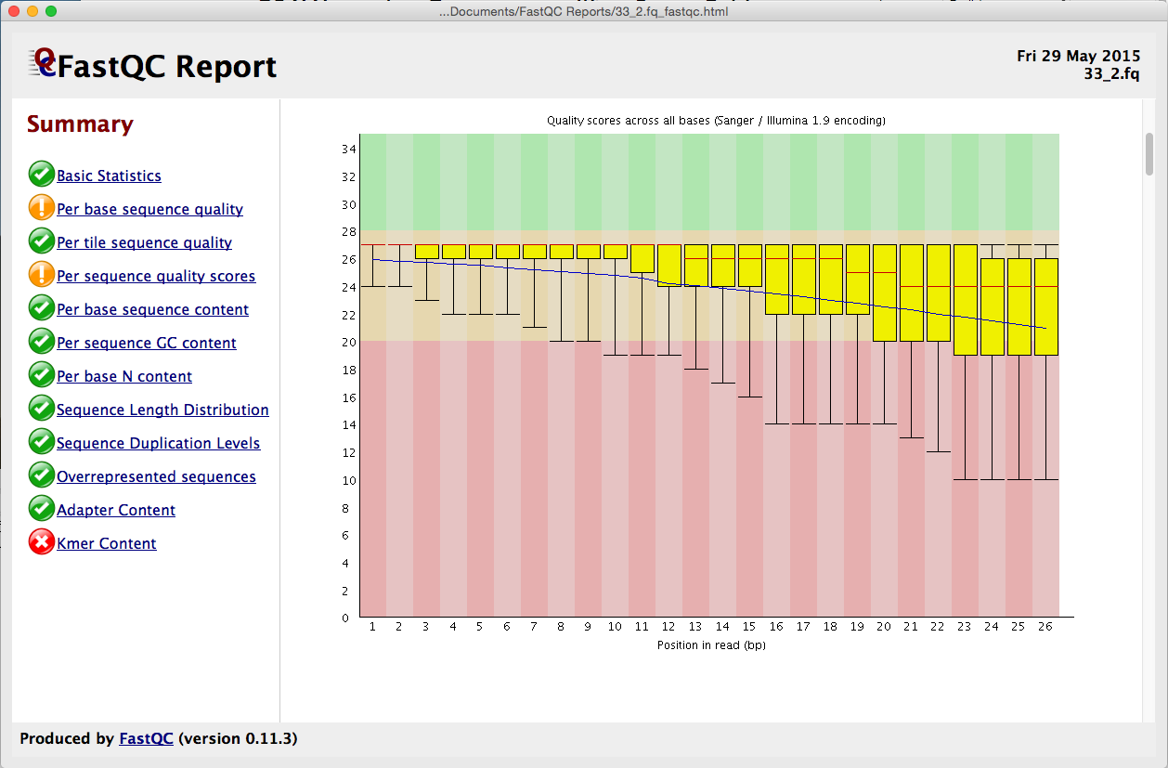
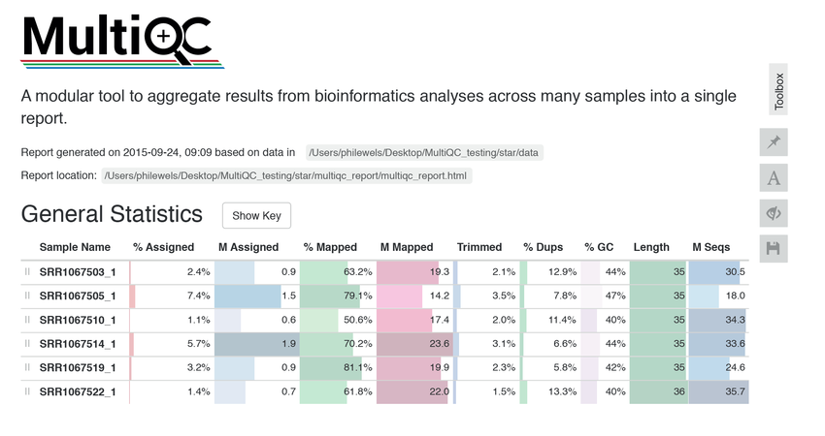
Demo #1 by Alexis Marshall on Quality Control
https://www.youtube.com/watch?v=7jRTyfdIXLo

